Slide 1
International study centre
Low level modelling, user interface and test modelling
Name : John Alamina
Email : john.alamina@hud.ac.uk

Slide 2
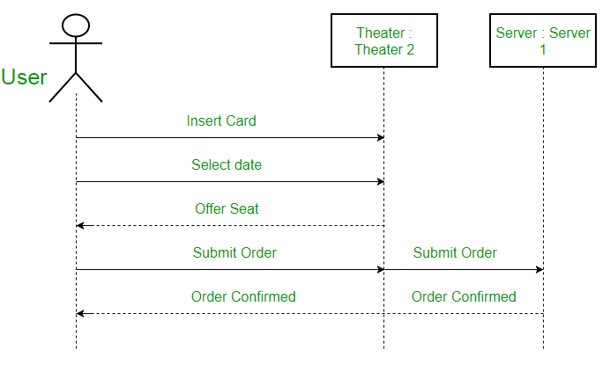
Sequence Diagrams
They depict interaction between objects in sequential order.
They are used for representing the logic and completeness of a usage scenario.

Slide 3
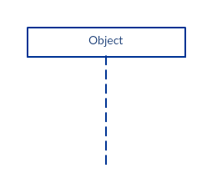
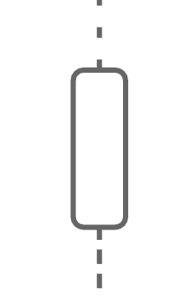
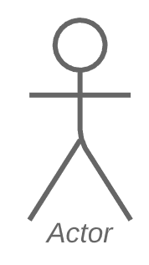



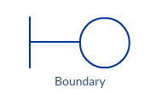
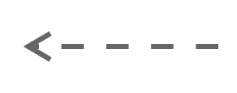
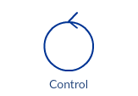

Sequence Diagram - Symbols
Symbol | Description (Lifeline Notations)
 | Object - represents different objects or parts that interact with each other in the system during the sequence.
 | Actor – is used when a particular sequence diagram is owned by a use case
 | Entity – represents system data.
 | Boundary – represents a system boundary such as databases or user screens
 | Control – indicates a controlling entity or manager. Serves as a mediator between entities and boundaries.
Symbol | Description
 | Activation bars – is used to indicate that an object is active during an interaction between two objects. The length indicates the duration of the objects staying active.
 | Synchronous message – is used when the sender waits for the receiver to process the message and return before carrying on with another message.
 | Asynchronous message – is used when the sender does not wait for receiver to process the message before sending other messages to other objects.
 | Return message – is used to indicate that the receiver is done processing the message and is returning control to the caller
 | Destruction occurrence specification – is used to delete a participant that is no longer needed

Slide 4
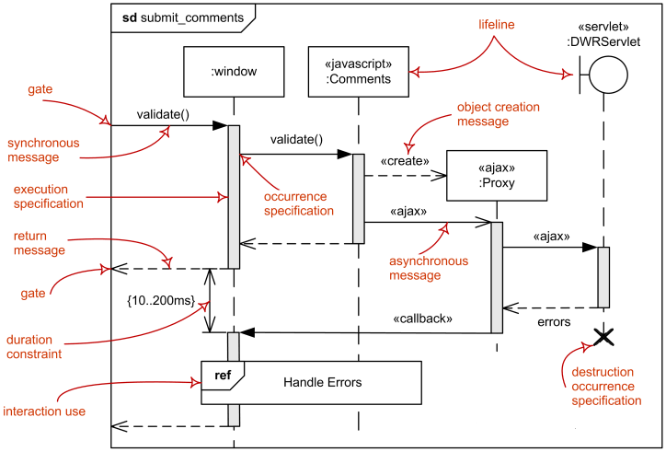
Terms Used in Sequence Diagrams

Slide 5
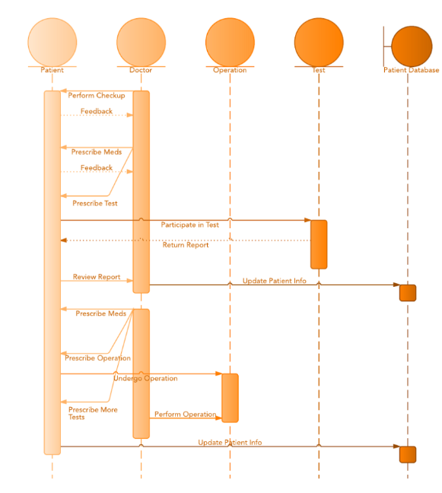
Sequence Diagram – Example and task
Example:
Task: Using the POS scenario given in the activity diagram task, create a sequence diagram with the following details:
Create the user as an actor, the POS as an entity, a control that verifies the pin and updates the database when the transaction is successful.
Create the database as a boundary and show all the events and responses with the appropriate arrow.

Slide 6
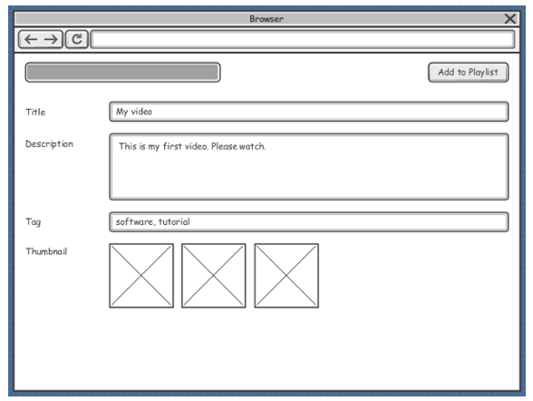
User Interface and Test Modelling – Wireframe.
Wireframe is a sketch of the system to be built. They are used to lay out content and functionality of a page taking into account user needs and use.
The actual screen design is based on the wireframe.
Connectors are used to describe relationships and directionality among views.

Slide 7
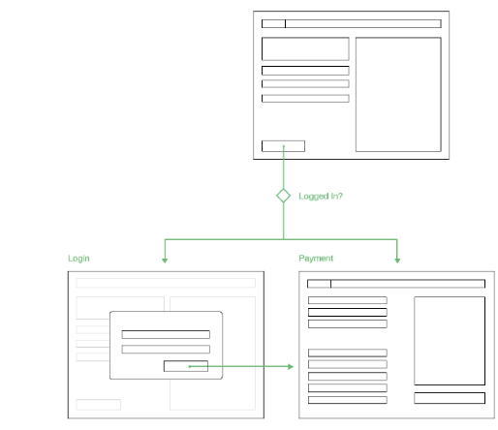
User Interface and Test Modelling – Wireframe.
Example:
Task : For the stated POS payment problem, develop a wireframe mockup model for at least four user interfaces, this should include the initial page, the incorrect pin page, the transaction approved page and the page asking if receipt is needed.

Slide 8
Any Questions?

